Slide 1
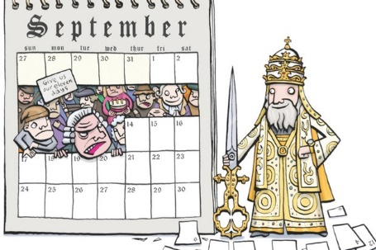
Calendar
Logical Reasoning
January
February
march
April
May
June
July
august
September
October
November
December

Slide 2
Lecture 1:
Difference between Regular and Leap Year
Concept of ‘Odd Day’
Concept of ‘Same Calendar’
Month Details
Practice examples on-
(i) Finding day with reference date
(ii) Finding day without reference

Slide 3
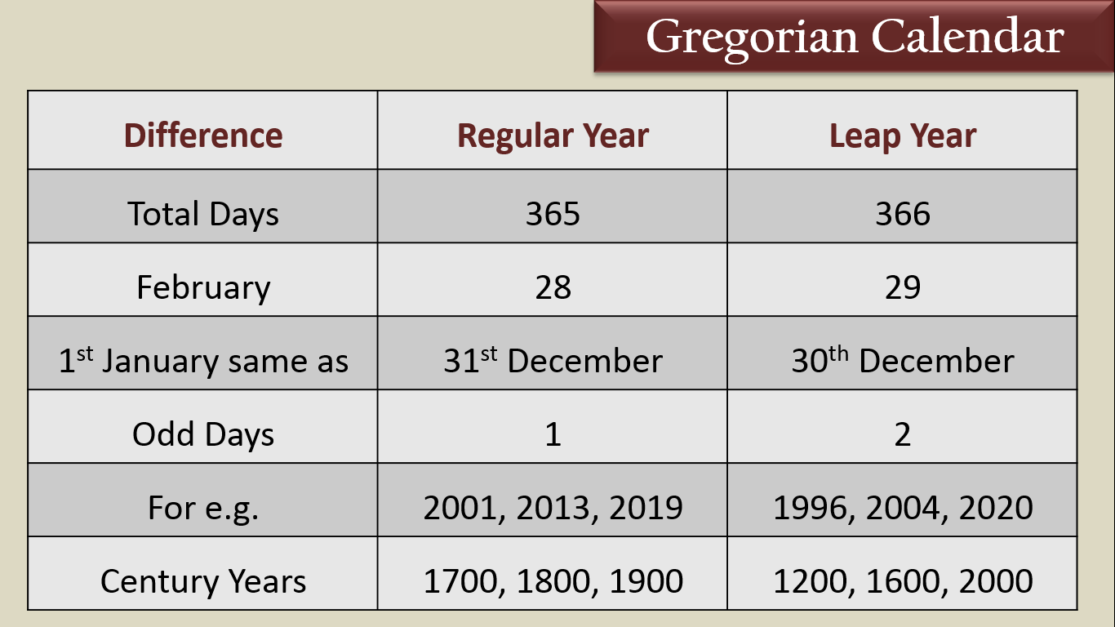
Gregorian Calendar

Slide 4
Odd Days
“Extra days after a week”
For eg.
8 days = 1 week + 1 day extra
10 days = 1 week + 3 days extra
13 days = 1 week + 6 days extra
14 days = 2 weeks + 0 day extra
36 days = 5 weeks + 1 day extra
‘Odd day number lies between 0 to 6 only’

Slide 5
Month Details
January
31
3
July
31
3
February
28/29
0/1
August
31
3
March
31
3
September
30
2
April
30
2
October
31
3
May
31
3
November
30
2
June
30
2
December
31
3

Slide 6
Same Calendar
After every 7 or multiple of 7 odd days completes, the calendar repeats
For eg. The calendar of 2013 will be same as
2013 -
2014 -
2015 -
2016 -
2017 -
2018 -
1
1
1
7
2019
2
1
1

Slide 7

Same calendar concept
Regular Year
Step 1
Step 1
+11
Regular Year
Leap Year
Step 2
Regular Year + 6

Slide 8
Find the same calendar for
2002
2019
1995
2001
2013
1973

Slide 9
Same calendar for Leap Year
2004
2020
2008
1944

Slide 10
Lecture 2:
Practice examples on-
(i) Finding day with reference date
(ii) Finding day without any reference

Slide 11
Lets solve
If today is 15 February 2019, Friday then 2nd October of the same year is,
February – 13 : 6 ( 28-15)
March – 31 : 3
April – 30 : 2
May – 31 : 3
June – 30 : 2
July – 31 : 3
August – 31 : 3
September – 30 : 2
October – 2 : 2
Friday
+ 5
Answer : Wednesday
12

Slide 12
Lets solve
If today is 27 December 2021, Saturday then 3nd August of the same year is,
August – 28 : 0 (31-3=28)
September – 30 : 2
October – 31 : 3
November – 30 : 2
December – 27 : 6
Saturday
- 6
Answer : Sunday
6

Slide 13
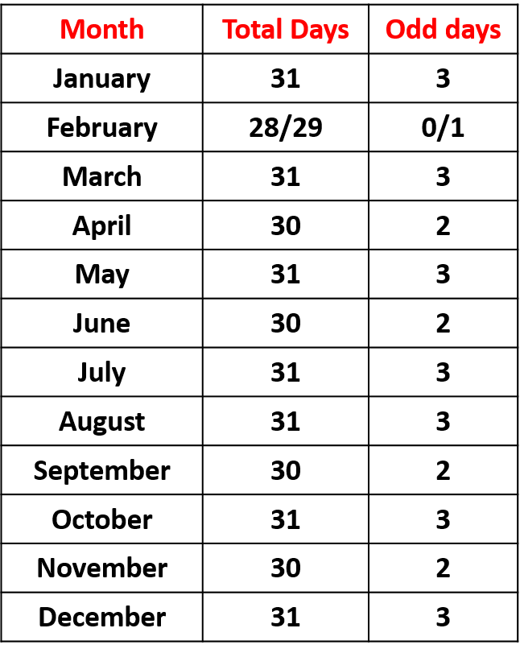
Practice
If 2nd April = Friday then
5th July of same year=?
TIME UP !!!!!
1
48
45
15
43
27
18
23
34
58
49
56
50
2
17
25
46
22
59
44
14
33
35
4
3
19
26
55
57
42
51
52
11
16
21
13
20
47
8
53
28
6
12
54
9
10
40
24
7
32
30
31
37
5
29
36
41
39
38
60
Notes:
Monday

Slide 14
Practice
If 14 February 2021 – Sunday
Then 6th June 2021 - ?
TIME UP !!!!!
1
48
45
15
43
27
18
23
34
58
49
56
50
2
17
25
46
22
59
44
14
33
35
4
3
19
26
55
57
42
51
52
11
16
21
13
20
47
8
53
28
6
12
54
9
10
40
24
7
32
30
31
37
5
29
36
41
39
38
60
Notes:
sunday

Slide 15
Practice
TIME UP !!!!!
1
48
45
15
43
27
18
23
34
58
49
56
50
2
17
25
46
22
59
44
14
33
35
4
3
19
26
55
57
42
51
52
11
16
21
13
20
47
8
53
28
6
12
54
9
10
40
24
7
32
30
31
37
5
29
36
41
39
38
60
Notes:
sunday

Slide 16
J F M A M J J A S O N D
1
4
4
0
2
5
0
3
6
1
4
6
L
0
3
Sun
Mon
Tue
Wed
Thu
Fri
Sat
1
day | month | Century | Year
2
16
17
18
19
20
6
L
=
3
4
4
2
5
0
6
6
0

Slide 17
J F M A M J J A S O N D
1
4
4
0
2
5
0
3
6
1
4
6
Sun
Mon
Tue
Wed
Thu
Fri
Sat
1
15 | 08 | 19 | 47
2
16
17
18
19
20
6
= 47/4=11..
3
L
4
4
15
3
0
47
11
2
5
1 +
3 +
0 +
5 +
4 +
0
6
6
Friday
6
0

Slide 18
J F M A M J J A S O N D
1
4
4
0
2
5
0
3
6
1
4
6
L
0
3
Sun
Mon
Tue
Wed
Thu
Fri
Sat
1
1 | 1 | 20 | 00
2
16
17
18
19
20
6
3
L
= 0/4= 0
4
4
1
0
6
0
0
2
5
0
1 +
0 +
6 +
0 +
0 +
6
0
Saturday
6
0

Slide 19


